Slide 1

ع ورت ک ا م

Slide 2
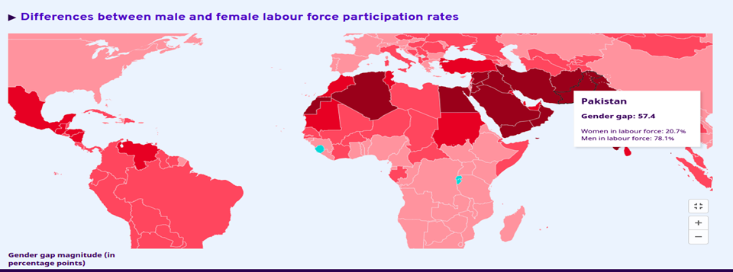
Gender gap in labor force
Source : ILOSTAT, ILO modelled estimates, November 2021

Slide 3
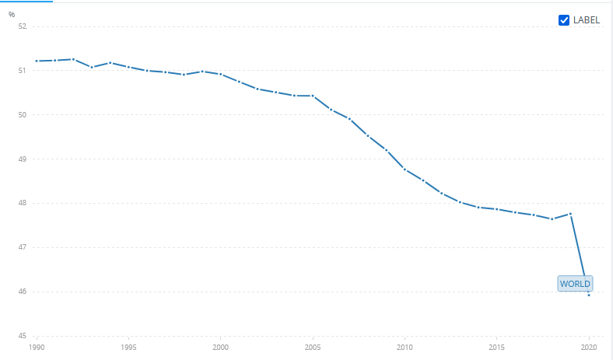
Percentage of female in labor force participation
Source: International Labour Organization, ILOSTAT database

Slide 4
Problem 1: Gender gap in labor force
When women are employed, they tend to work in low-quality jobs in vulnerable conditions, and there is little improvement forecast in the near future.

Slide 5
Problem 2: Insecure working environment for skilled women.
Women’s participation in the labor market varies greatly.
Focusing on these issues is critical because female labor force participation is a key to promoting inclusive growth and achieving the Sustainable Development Goals.

Slide 6



Random User Survey
“There is a need to form a common workplace where women can benefit from their skills like tailoring.”-Person 1
“There is a less female representation in the career of Tourist Guide for women only groups.”-Person 2

Slide 7

Where should I look for better earning opportunities ?
Remote workplace to sell services?
How shall I make use of my skill set?
Safe environment to work?

Slide 8

Key Goals
Promote women’s economic rights and independence, including access to employment, appropriate working conditions and control over economic resources.
Facilitate women’s equal access to resources, employment, markets and trade.
Strengthen women’s economic capacity and commercial networks.
Eliminate occupational segregation and all forms of employment discrimination.
Create a competent marketplace for women.

Slide 9


Slide 10


Slide 11
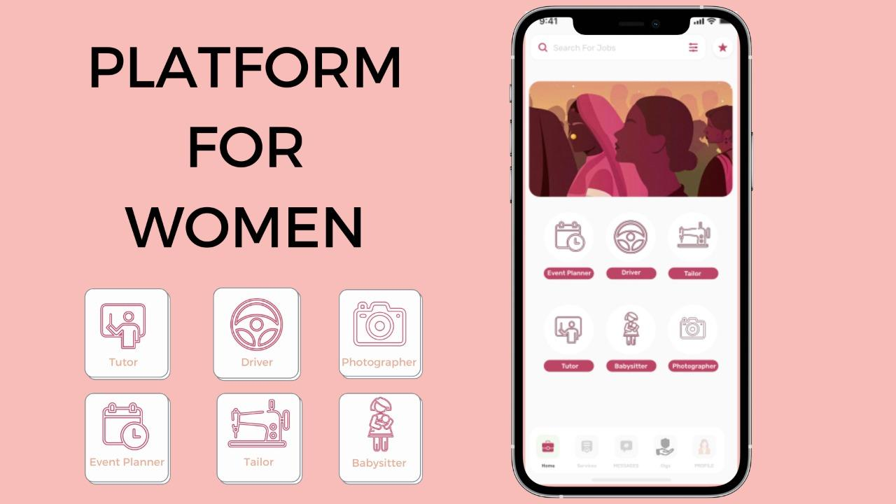

Slide 12


Slide 13




One stop solution for financial stability, opportunity building platform and secure marketplace for women
Sell your services and earn.
Work for what you love the most.
Get employed.
Connect with women and build a network.

Slide 14
Business Model
The revenue model of FindHer is based on charging a fee for every successful service performed through the platform:
The Service Provider is charged a variable fee based on the billing of service whether its an hourly or a fixed price service.
The Service consumer is charged a fixed percentage of the service that she has consumed.

Slide 15
Competitive Advantages
-Insured Services:
- The users are provided with an additional option of insurance coverage to purchase protection against unexpected financial losses.
- Loyalty Points:
- Users are awarded loyalty points on every successful service transaction.
- These points can be redeemed by availing discounts on future services.
- The other incentive includes ranking of users based on these points.

Slide 16




Technologies
FLUTTER
AWS S3
AWS REKOGNITION
AWS RDS

Slide 17
FLUTTER:
Intended for developing cross-platform applications.
AWS S3:
Intended to store data(i.e portfolio, business analytics) for reduced cost and operational complexities.
AWS REKOGNITION:
Intended for verifying identity of women using pre-trained models
AWS RDS:
Intended for efficient database management without infrastructure and maintenance overhead.

Slide 18
FAQ’s
If a long term relation is maintained between between client and customer , how will you earn?
Maintain badges and give good rating to customers so as to increase credibility and higher the rating , the lower the commission.
What if a customer complains that the service provider had stolen my assets?
The platform will have a partnership with insurance company.Each women(consumer) on placing the service order will commit to “Book with Insurance” policy and the company will be responsible for reimbursement and also A negative rating will be assigned to the women service provider. On 3 consecutive warnings , legal action will be taken.

Slide 19




Team
FindHer
Subhan Saleem
Ahsan Akhtar
Ahmed Raza
Mustafa Bawany

Slide 20
Women Labour Platform
Our solution aims to create an intangible arena for supply and demand of women labour interact to promote women empowerment through connecting women sellers and buyers over a single platform; thus making them active agents of economic and social change in Pakistan.

Slide 21
Problem Solutions
Opportunity building platform for all the women.
Providing a platform where all the women can come and find opportunities of their respective fields.
Support the community of women currently working in technology and to help pave the way for women and young women who want to enter the industry.

